Slide 1
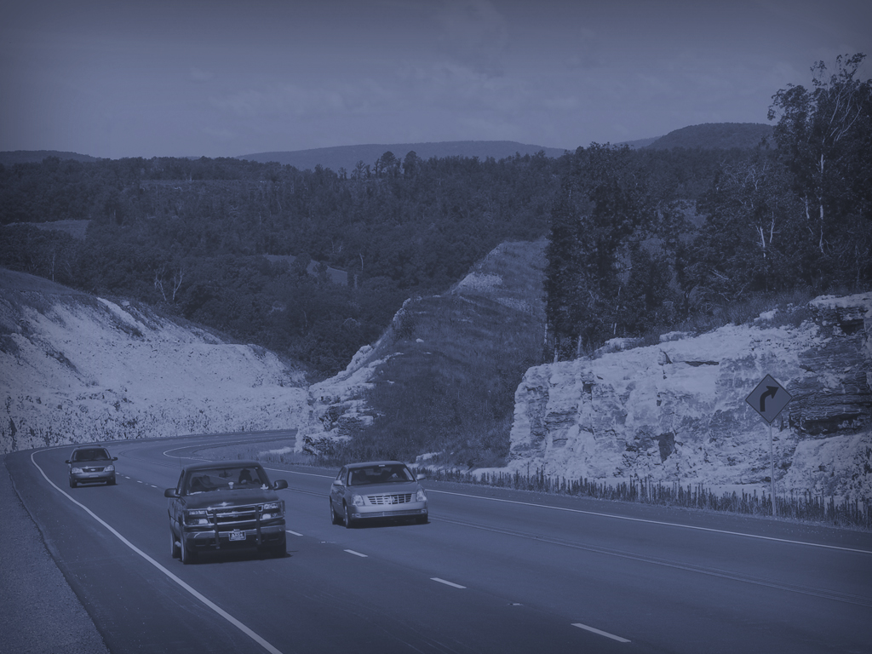

Kevin Thornton, P.E.
Assistant Chief Engineer - Planning
Transportation Research Committee Engineering Conference
Wednesday, August 14, 2019
Notes:
Good afternoon, I’m Kevin Thornton, Assistant Chief Engineer of Planning for the Arkansas Department of Transportation.
I’m happy to be meeting with you today as we begin the 108th Transportation Research Committee Engineering Conference!

Slide 2
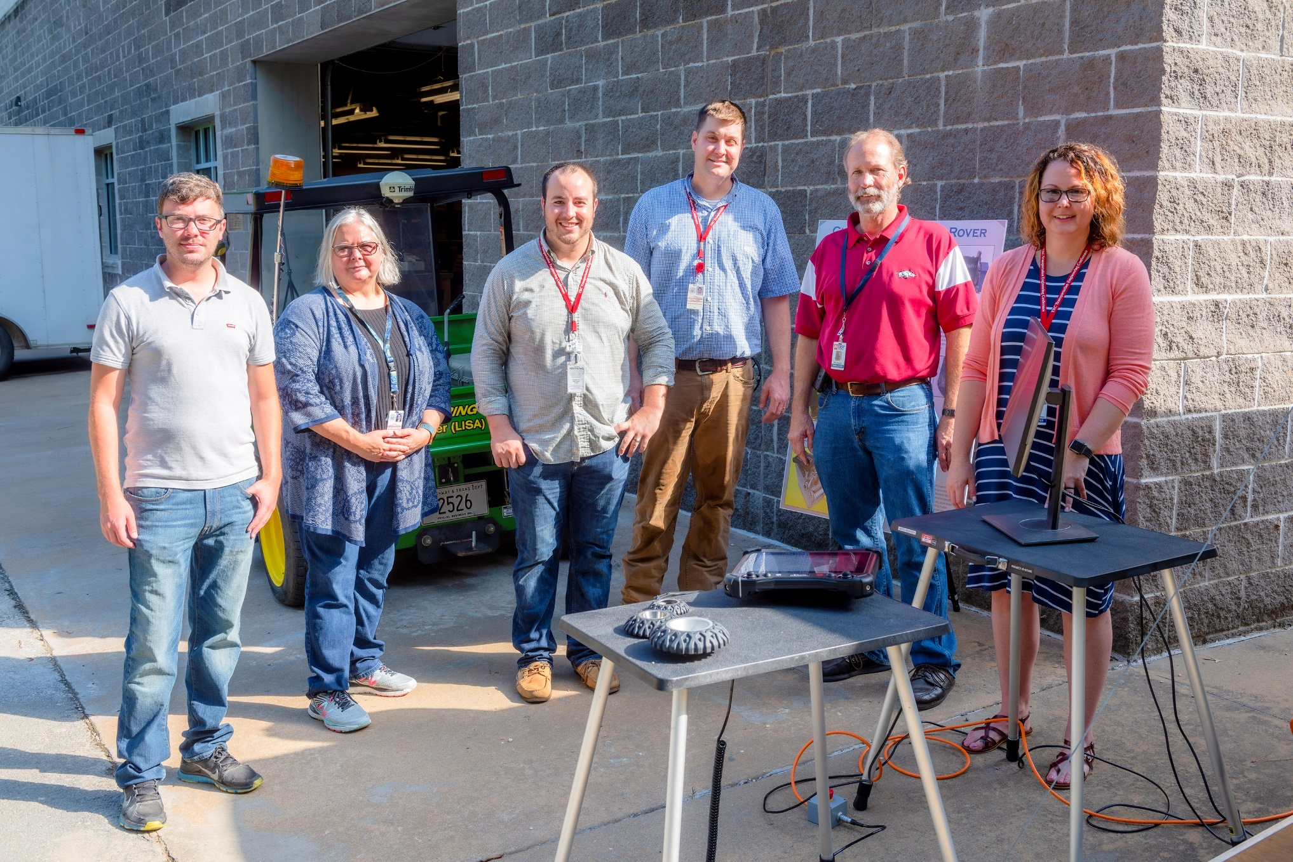
Notes:
Before I begin today, I want to take a minute to thank a few people.
These pictures include the people that are responsible for this conference.
This Conference counts as two.
We were forced to cancel the first one this year due to the Arkansas River flooding.
Not only did this team put the first conference together, they had to cancel it as well, which is no small task.
Then, they got to work putting it back together.
They are, from left to right:
Patrick “Ross” Phillips,
Kim Romano,
William “Will” Caster,
Chris Dailey,
Mark Simecek,
Elisha Wright-Keyner

Slide 3
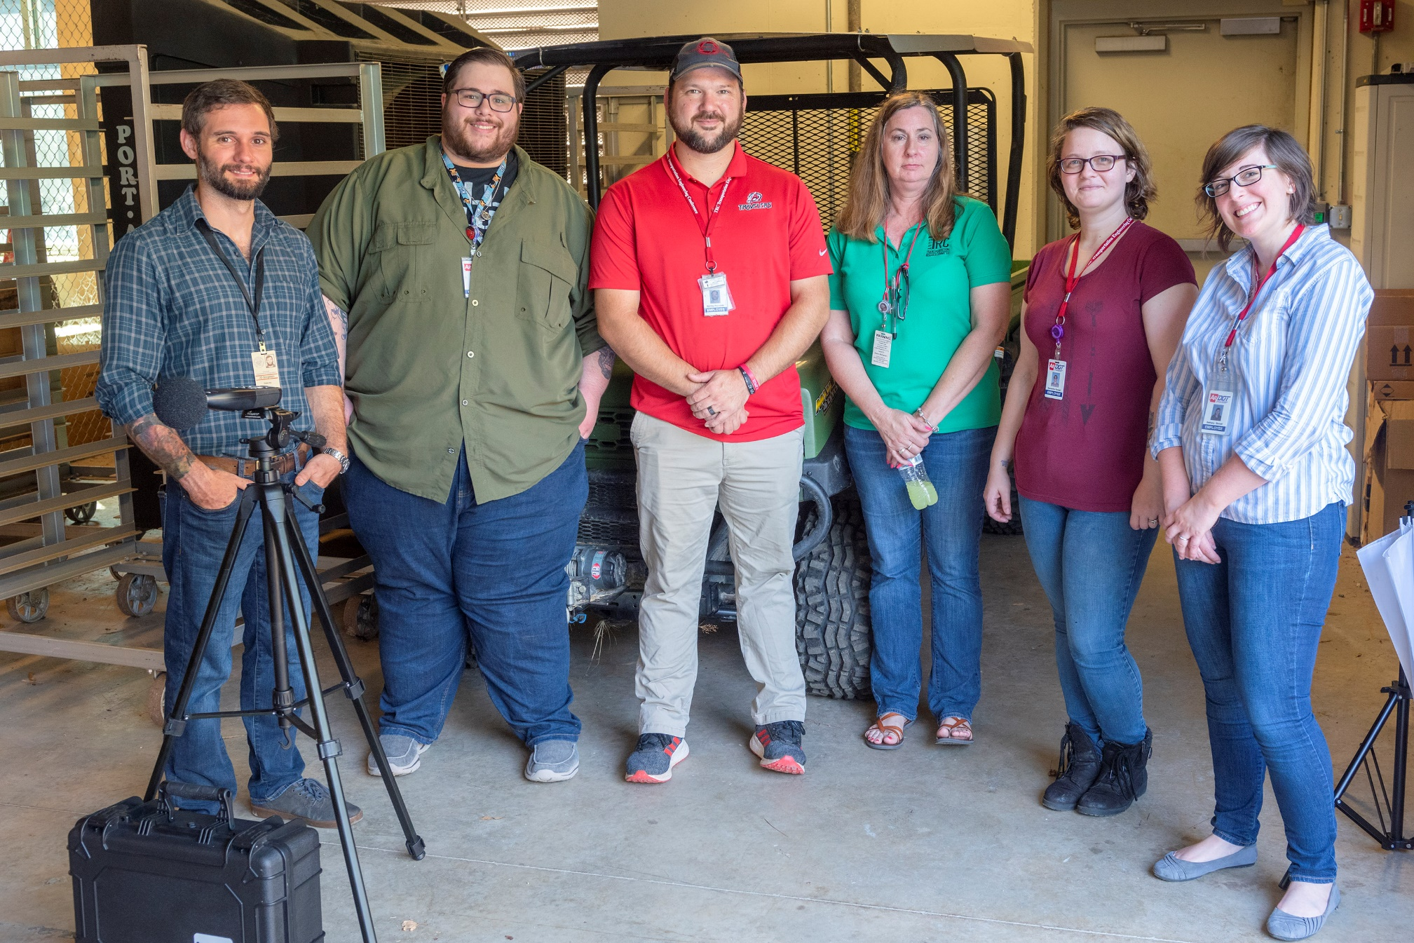
Notes:
Again, from left to right:
John “J.D.” Borgeson,
Parker Taylor,
Bentley Reynolds,
Karen McDaniels,
Samantha “Sam” Rensel,
Bethany Stovall

Slide 4
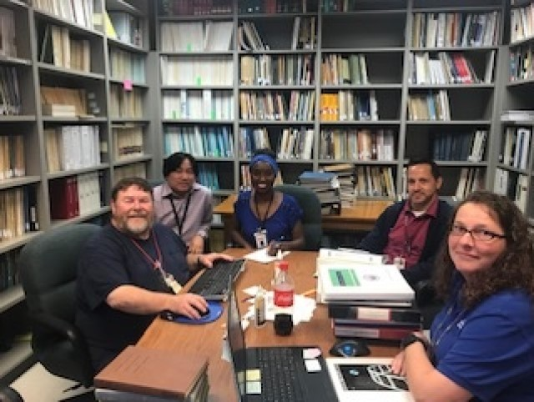
Notes:
Again, from left to right:
Davin Webb,
Sanghyun (pronounced sing-young) Chun,
Laura Carter,
Chris McKenney, and
Robin Russell
I want to publically thank them for all of their dedication and hard work – not only for this conference, but for everything they do on a daily basis to improve the transportation system here in Arkansas.
Ove the next few days when you see them, be sure to thank them for all that they do.

Slide 5
Recent Legislation
Notes:
One of the these areas where we have been successful is in the last Legislative Session.
The recent General Session has provided additional funding for highways in Arkansas.

Slide 6

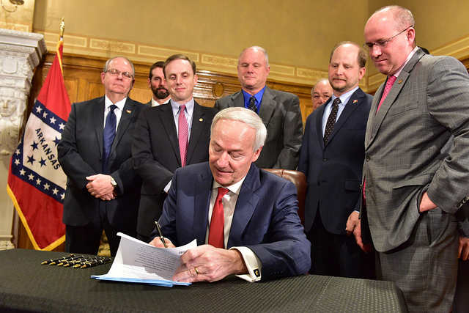
State Highway Funding
Governor Hutchinson’s Highway Package
Two Bills
Four Revenue Sources
$300 Million Per Year
Notes:
On February 11th, he announced his long-awaited highway funding legislative package:
Two bills – Well, actually it was:
One bill, which became Act 416 (Senate Bill 336)
One proposed Constitutional Amendment –
House Joint Resolution 1018.
The package draws revenue from four funding sources:
Motor fuel taxes
Registration fees on electric and hybrid vehicles
Casinos
Sales tax
If the entire package is enacted, it would provide new revenue for highway maintenance and construction totaling $300 million per year.
Plus, additional money for cities and counties on top of that.
Here’s a quick breakdown of the two pieces of legislation.

Slide 7
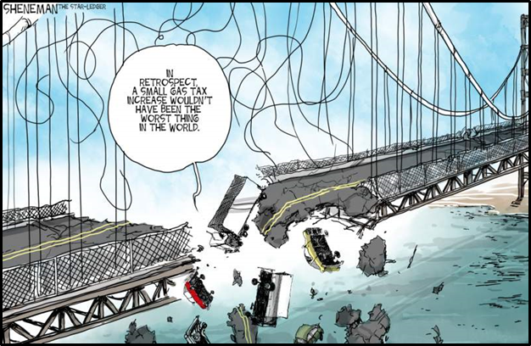
Act 416
Motor Fuel Taxes
1.6% Tax On Wholesale Price of Gas
(equals 3 cents per gallon)
2.9% Tax On Wholesale Price of Diesel
(equals 6 cents per gallon)
Notes:
Act 416 provides new revenue for roadways from three sources:
Motor fuel taxes
Electric and hybrid vehicle registration fees
Casinos.
I’ll start by talking about the motor fuel taxes.
Currently, gas and diesel are taxed based on consumption of the number of gallons purchased.
We currently pay 21.5 cents per gallon on gas, and 22.5 cents per gallon for
on-road diesel. It makes no difference if the price of the fuel is high or low, the amount of tax is based on the number of gallons you buy, not the price.
And that’s the inherent problem with per-gallon motor fuel taxes. It’s everyone’s goal to reduce consumption, and we are achieving that goal. As vehicles get more miles per gallon, our revenue decreases because consumption is decreasing.
This bill adds a percentage tax on the wholesale price of gasoline and diesel.
It places a tax of 1.6% on the wholesale price of gasoline, and 2.9% on the wholesale price of on-road diesel.
For collection purposes, the tax on the wholesale price is converted to a
cents per gallon amount.
But it amounts to a 3 cents per gallon increase on gas, and a 6 cents per gallon increase for on-road diesel.

Slide 8
Act 416
Motor Fuel Taxes
Results in $86 Million in Additional Annual Revenue
$58 Million to ARDOT
$14 Million to Cities and Counties Each
“And we feel like we would like to invest and spend money to make the roads better so that they are safer, so that they are easier on the equipment, so that the volume of traffic can move more freely. The benefit of those things outweighs any increased costs.”
– Shannon Newton, Arkansas Trucking Association President
Notes:
The 3 cents per gallon increase for gas combined with the 6 cents increase for diesel will result in approximately $86 million in additional revenue annually.
This amount is subject to the traditional 70/15/15 revenue split with cities and counties.
This means ARDOT will receive 70% of the revenue, or about
$58 million.
Cities and counties will receive 15% each or an additional $14 million each.
You might be wondering what some others are saying about this increase.
Shannon Newton, President of the Arkansas Trucking Association, said
“. . we feel like we would like to invest and spend money to make the roads better so that they are safer, so that they are easier on the equipment, so that the volume of traffic can move more freely. The benefit of those things outweighs any increased costs.”

Slide 9

Act 416
Electric and Hybrid Vehicle Registration Fees
Electric Vehicles - $200 Registration Fee
Hybrid Vehicles - $100 Registration Fee
$2 Million to ARDOT
Notes:
Act 416 also adds a new registration fee on electric and hybrid vehicles.
Electric vehicles will now pay a $200 annual registration fee.
Hybrids will pay $100 annual registration fee.
For now, there are not many electric vehicles in the state – fewer than 500 total.
And, there are about 17,000 hybrids.
So this is not a large revenue source – about $2 million a year in new revenue.
The issue here is fairness.
These vehicles currently pay zero or very little in fuel taxes, but they use the roads and contribute to the wear and tear.
We are seeing more and more of these vehicles on the roads, and they are replacing the fossil-fueled models.
So even though we are calling this new revenue, this will eventually be revenue that takes the place of the traditional per gallon gas and diesel taxes.

Slide 10

Act 416
Casino Revenue
All New Casino Revenue
$35 Million Annually to ARDOT
Notes:
And finally, Act 416 directs all new casino revenue to highways, guaranteeing that amount to be at least $35 million annually.
It does not direct all casino revenue to highways.
The first $31.2 million collected will go to General Revenue.
That’s the amount that is currently collected from the existing casinos at Oaklawn and Southland.
That amount will continue to flow into General Revenue to hold it harmless
In other words, GR will not see a reduction in the funding flowing into it.
But all revenue above the $31.2 million is dedicated to highways.
At the end of the state fiscal year, all revenue above $31.2 million will be transferred to the highway account.
If the amount to highways is less than $35 million, the difference will be made up from the Restricted Reserve Fund controlled by the Governor to ensure that highways receive at least $35 million per year.
As expansion takes place at Oaklawn and Southland, and up to two more casinos are built, the casino revenue is expected to increase.
Per DF&A projections, by 2025, total casino tax revenue to the state is expected to exceed $66 million, meaning GR gets their 31.2 million and highways will receive their $35 million with no transfer from the Restricted Reserve Fund needed.
There is no cap on the amount of funds ARDOT can receive from the casino tax.
It should also be noted, the DF&A projections are based on expanded casinos at Oaklawn and Southland, and one new casino in Jefferson County.
Their projections do not take into consideration an authorized new casino in Pope County.
If one is built in Pope County, even more revenue could potentially be generated for highways.
CONTINUED ON NEXT PAGE

Slide 11
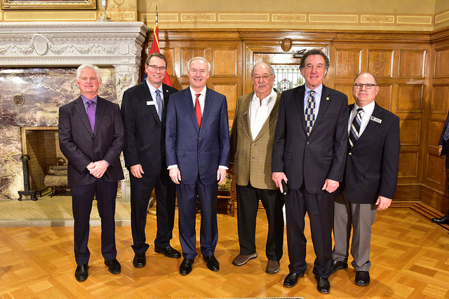
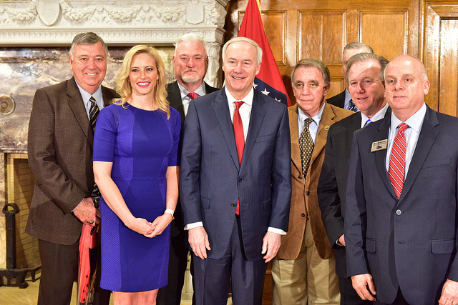
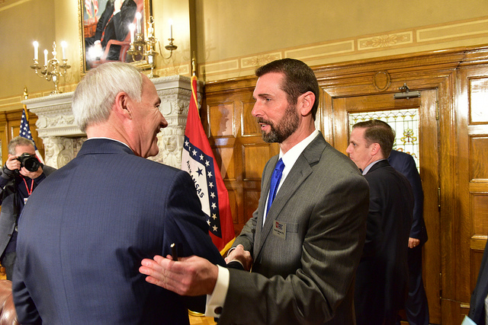
Act 416
Summary
Motor Fuel Tax $ 58 Million
Electric and Hybrid Vehicle Registration Fees $ 2 Million
Casino Revenue $ 35 Million
Total to ARDOT $ 95 Million
All for System Preservation, Pavements, Bridges, etc.
Notes:
So here’s a summary of what the Department can expect from
Act 416.
We’ll see this money starting to flow to ARDOT by the end of this year, meaning we’ll see work on the ground from this new revenue by this time next year.
The great news for the motorists and citizens of Arkansas is that ALL this money will be used for taking care of our existing highways.
You’ll see overlays, you’ll see shoulder work, and you see lots of work on bridges.
That’s our commitment – that this money will all go toward taking care of what we already have.
Click to remove photos and display text.

Slide 12
House Joint Resolution 1018
Proposed Constitutional Amendment
To Be Voted On In General Election – November 2020
½-Cent Sales Tax Permanent After 2023
Continues To Provide $205 Million To ARDOT Annually
Continues To Provide $43 Million To Cities Annually
Continues To Provide $43 Million To Counties Annually
Notes:
The final component to the Governor’s Highway package is the proposed constitutional amendment. It will be voted on by the people in the next general election – November 2020.
It will take the current temporary ½-cent sales tax that expires in 2023 and make it a permanent revenue source for highways.
The current temporary ½-cent tax was voted in by the people in Nov. 2012 and is dedicated to a specific set of large, expensive projects – the Connecting Arkansas Program. Those projects will be completed and the accompanying bonds will be paid off in 2023 when the temporary tax is set to expire.
But if the people choose to support it at the polls, that revenue stream will continue, providing ARDOT with about $205 million in annual revenue to maintain and improve our state highway system. It will also continue to provide cites and counties with approximately $86 million annually.
We plan to use half of this money – at least $100 million – on more system preservation. More work on pavements, more work on bridges.
As a matter of fact, if the extension of the ½-cent sales tax passes, we’ll be able to repair or replace all the weight restricted bridges on the state highway system over the next 10 years.
So as you can see, the proposed Constitutional Amendment is a significant component of the Governor’s plan– fully two-thirds of the total revenue.

Slide 13
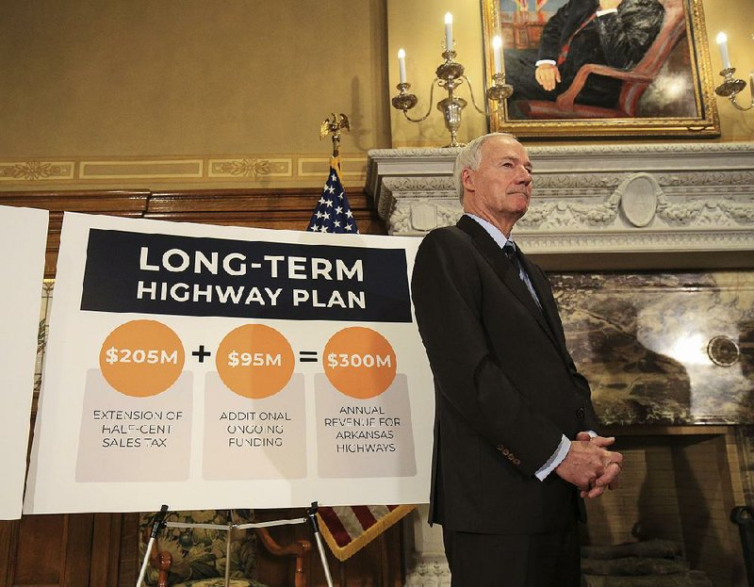
Governor’s Highway Funding Package
Summary
Act 416 $ 95 Million
House Joint Resolution 1018 $205 Million
Total To ARDOT $300 Million
Notes:
If the Constitutional Amendment passes, this is a summary of the new funding that will be available to the Department:
Act 416 provides $95 million per year
House Joint Resolution 1018 - Constitutional Amendment will provide , if passed, $205 million per year
The Total to the Department will be $300 million per year
So that’s the program. We’re excited and thankful to actually be able to make a difference for Arkansas’ road users by making significant improvements to the quality of our roads!!!

Slide 14
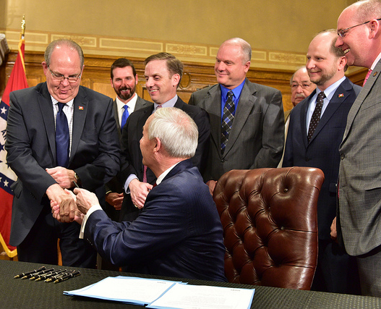
Recipe for Success
Consensus
Unity
Bipartisanship
  Governor
  Legislature
  Stakeholders
  ARDOT
Notes:
The main key to the success of this revenue package was a concerted effort by the Governor, the Legislature, a strong coalition group of stakeholders and ARDOT to find consensus and unity on how to achieve the goal of having adequate and sustainable funding Arkansas’ transportation system.

Slide 15
Funding Challenges
Notes:
As a reminder, let me take a few minutes and explain how we got to where we are.
Our biggest challenge over the past few decades has been not only trying to increase revenue for highways, but also trying to maintain our highway system with our inadequate level of revenue that comes to us from our outdated highway funding mechanism.

Slide 16
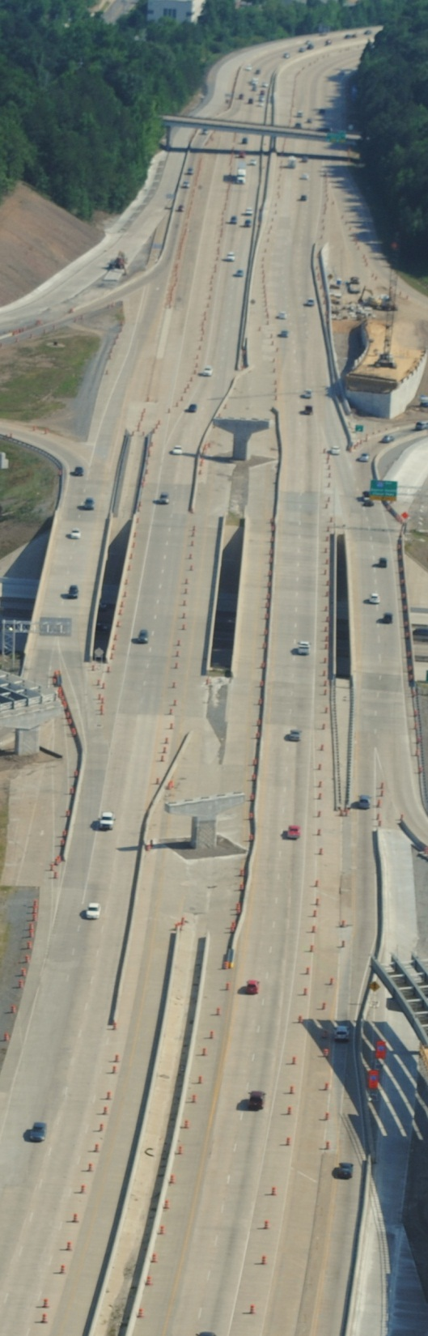
Challenges
12th largest system in the country
41st in highway revenue per mile.
$9.3 billion in needs
$4.5 billion in available revenue
“This is a problem that we can’t leave for our children or grandchildren to solve.”
  ~Arkansas Department of Transportation Director
  Scott Bennett
Notes:
We have the 12th-largest highway system in the nation. More than CA, NY, FL. But we are near the bottom when it comes to being able to fund that system.
Over the next ten years—statewide-we estimate $9.3 billion in “real” needs just to take care of the system, but only expected $4.5 billion in revenue over that same time.
This does not include capital and economic development corridors – like completing I-49. To accomplish all of the capital improvements that have been identified would require about $23 billion.
That number does not include the revenue we are receiving from the half-cent sales tax ($1.6 billion). That money is dedicated to a specific subset of projects. But even factoring that in, you can see the immense imbalance.

Slide 17

All State Highways – Including Interstates
24%
28%
58%
18%
26%
Current
Condition
2027
Condition
Notes:
So, with a $480 Million shortfall each year, the condition of our system continues to deteriorate.
This graph gives a visual reference for the situation.
The column on the left shows the current condition the State Highways that are on the Arkansas Primary Highway Network.
18% of our pavements are in good condition.
58% are in fair condition
24% are in poor condition
If we continue to allocate funding as we current do, then in 2027:
26% of our pavements will be in good condition.
46% will be in fair condition
28% will be in poor condition
The point to be made here is that each year more of our system is in poor condition!

Slide 18

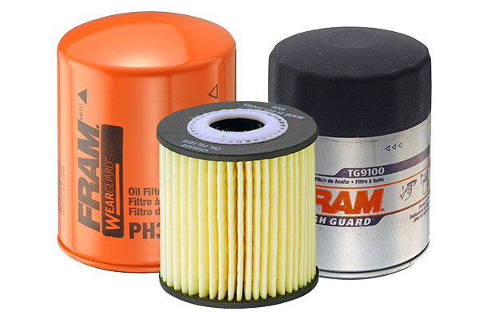

Pay a Little Now
Pay a Whole Lot Later
Overlay
$100,000
per lane mile
Reconstruction $1,500,000
per lane mile
Notes:
One of the reasons it is important to take care of the existing roads is that if you have a highway that is in fair condition and you overlay it in a timely manner, you can extend the life of the pavement significantly, approximately 12 to 20 years depending on the amount and type of traffic.
If the $$ aren’t available to provide this maintenance, the road continues to deteriorate to the point that an overlay will not repair the road.
It will require reconstruction.
Overlay $100,000/ mile vs Reconstruction $1.5 million/mile because you basically have to tear the road out and rebuild it.
Old Fram Commercial?
So you can see that having the funds to adequately maintain our system is very important and in the long run will save money.
The money saved is not only in construction costs, but also for the road users since the highways are safer and the wear and tear on vehicles is significantly reduced.

Slide 19

$10,000,000 Overlay Program
THEN
NOW
In 1995, 200 miles of highway could be overlaid with $10 million.
Using $10 million today, only 54 miles of highway can be overlaid.
Notes:
To compound the problem –
While our revenues have remained basically stagnant over the years, inflation has risen significantly.
Back in the 1990’s, we could overlay about 200 miles with $10 million.
And now, some 20 years later, we can only over about 54 miles, or about a quarter of what we could accomplish in the 90’s.

Slide 20


Percent of Highway vs. General Revenue
1999 Fuel Tax Increase
1991 Fuel Tax Increase
1985 Fuel Tax Increase
Notes:
So how did we get here? Our Highway funding mechanism is outdated – the funding mechanism is broken.
As you can see our revenue line is fairly flat even as general revenue grew exponentially.
This is a graph of General Revenue as compared to Highway Revenue.
The top line is for General Revenue.
The bottom line is for Highway Revenue.
As you can see from the graphic, total highway revenue was
14.4% of GR in 1980.
But then look what happens –
Highway revenue as a percentage of GR steadily drops from:
14.4% in 1980
11.3% in 1988
9.4% in 1996
8.7% in 2004
7.6% in 2012
6.6% in 2016
And that includes three fuel tax increases – 1985, 1991, 1999.

Slide 21

Highway Revenue at 14.4% of General Revenue
14.4%
$829M
14.4%
$931M
14.4%
$455M
14.4%
$626M
14.4%
$139M
14.4%
$259M
Notes:
This slide shows what it would have been like if highway revenue would have simply grown at the same rate as General Revenue.
What if Highway revenue, as a percentage of GR, would have stayed at 14.4% throughout these years?
As you can see, if Highway revenue simply grew at the same rate as GR (14.4% all the way across), our revenues would have looked like this:
$259M in 1988,
$455M in 1996,
$626M in 2004,
$829M in 2012,
and $931M in 2016.
If Highway revenue had maintained growth similar to General revenue, we would not be having this conversation today, we would have the revenue we need to maintain our system.
But we all know that didn’t happen.

Slide 22
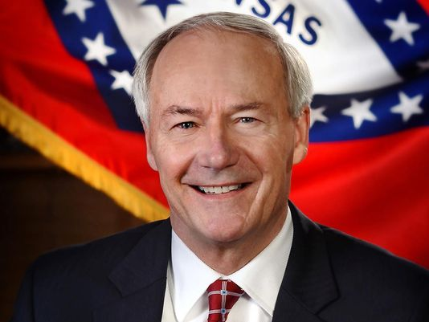
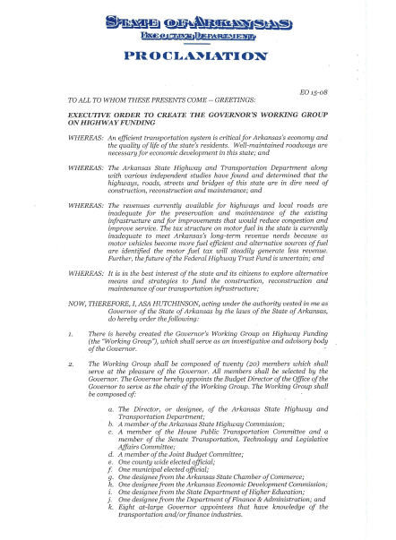
Governor’s Working Group on Highway Funding
“An efficient transportation system is critical
for Arkansas’ economy and the quality of
life of the state’s residents.”
Notes:
Recognizing this problem, Governor Asa Hutchinson back in 2015 issued an executive order to create the Governor’s Working Group on Highway Funding. This group served as an investigative and advisory body of the Governor to explore alternative means and strategies to fund the construction, reconstruction and maintenance of Arkansas’ roads and bridges.
The working group consisted of 20 members from a wide range of interests. Highway Commissioner Alec Farmer, former Highway Commissioner Frank Scott, and ARDOT Director Scott Bennett were all part of the working group.
In his executive order, Governor Hutchinson stated, “An efficient transportation system is critical for Arkansas’ economy and the quality of life of the state’s residents.”
He added, “The revenues currently available for highways and local roads are inadequate for the preservation and maintenance of the existing infrastructure and for improvements that would reduce congestion and improve service.”

Slide 23

Governor’s Highway Funding Working Group
Funding Targets
    Immediate: $ 50 Million
    Short-term (0-3 years): $110 Million
    Mid-term (3-5 years): $250 Million
    Long-term (6-9 years): $400 Million
  All figures are annual
  amounts for state highways.
Notes:
One of the best things to come out of the Governor’s Highway Funding Working Group was the establishment of funding targets for transportation investment.
They set a long-term goal of $400 million per year (after the 30% is taken away for cities and counties) to be able to maintain our highway system and to continue to make some of the major improvements for economic development.
There were some that questioned the amounts you see, especially the long-term amount of $400 million per year.
So, Arkansas Legislative Audit was asked to look into this and see if this amount was accurate.

Slide 24
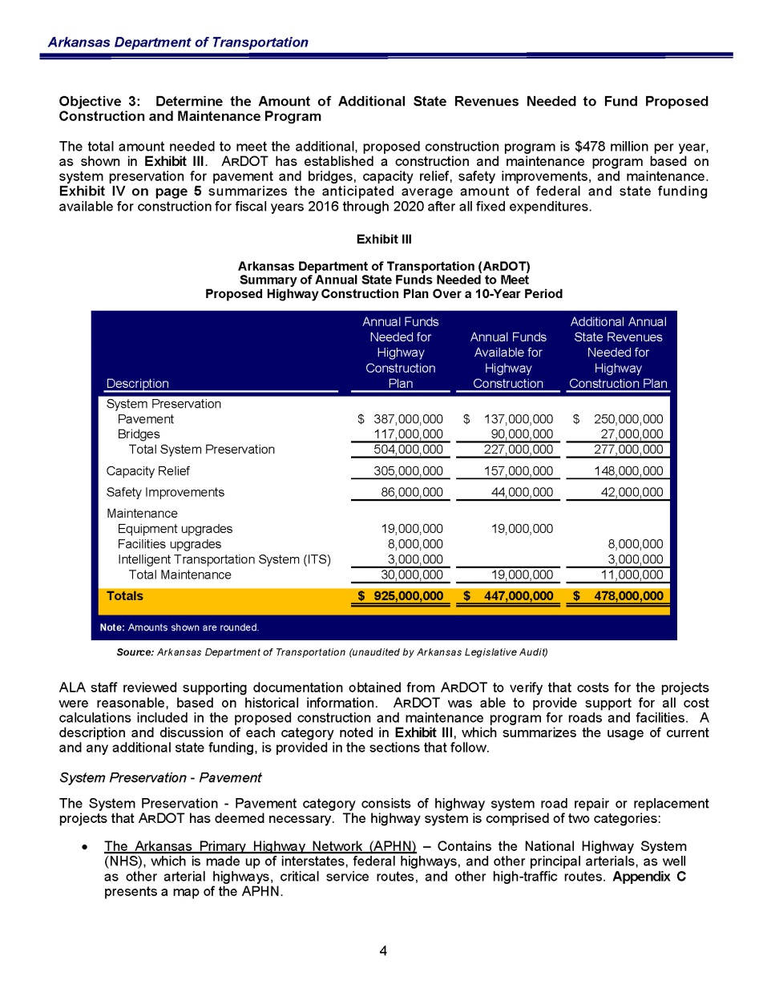
Arkansas State Legislative Audit
$ 478,000,000
Notes:
$925 million in needs versus
$447 million in revenue,
leaving a shortfall of $478 million.
This means we are short each year by $478 Million to keep the State Highway System in a state of good repair.

Slide 25
Looking Forward
Notes:
So, what’s next?
While we are pleased with the new funding and the potential for even more funding, we know that now we must deliver on our promises.
Now that we have been entrusted with these additional funds, it is imperative that we keep our promise and give the citizens of Arkansas the transportation system we have promised.
This is where you come in.

Slide 26
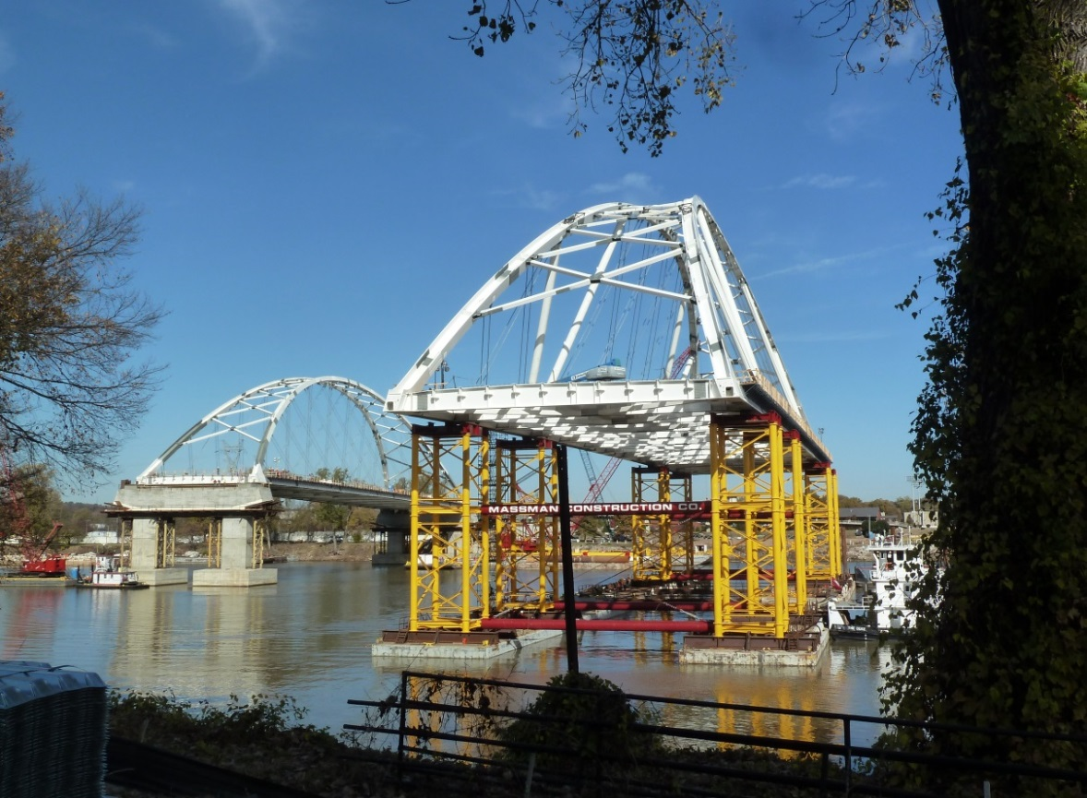
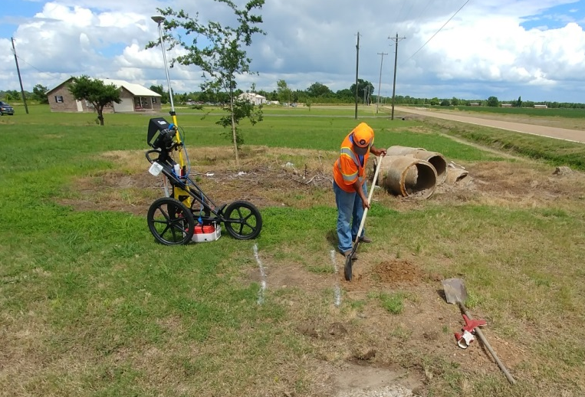
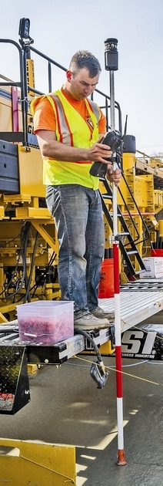

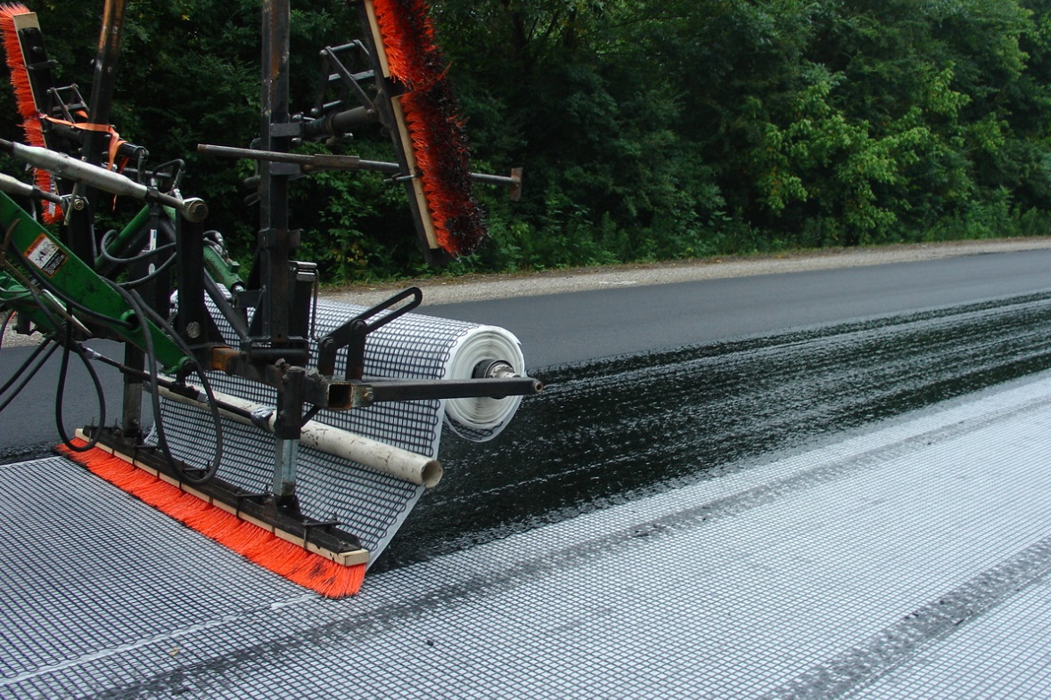
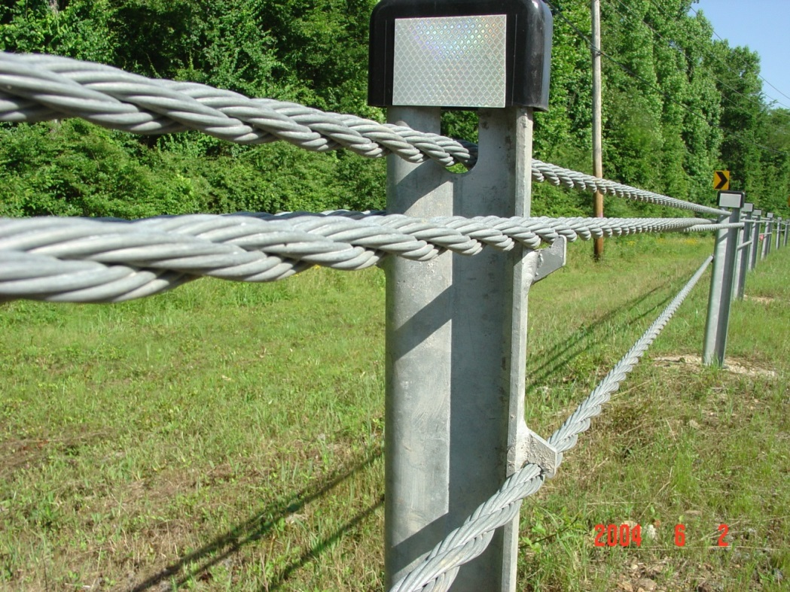
Notes:
We must continue to bring innovation into our practices.
Your ideas need to become part of our normal process in how we deliver projects.
Just like many of the previous topics that have become “business as usual” after being discussed at other TRC Conferences.
Such as:
Design-Build Projects
Construction Manager/General Contractor
eConstruction
Ground Penetrating Radar
Cable Median Barriers
Superpave
Pavement Preservation Treatments
These ideas have contributed to our efficiency and towards reaching our goals.
Your efforts have helped this Department to be trusted with additional funding when voted on by the people of Arkansas.
But, we must remember that the citizens of this State still have to vote for providing the final 2/3rds of the Governor’s Highway Package & we want to continue giving them reasons to trust us.

Slide 27
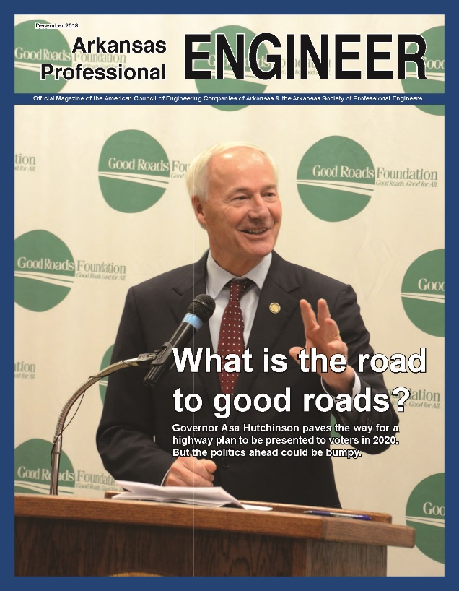
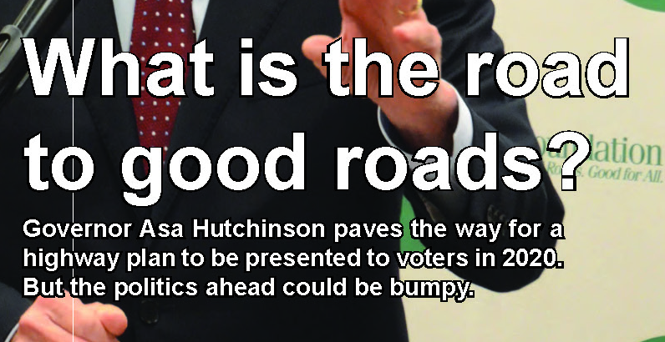
Looking Forward
ARDOT / Cities / Counties
Educate Public
Stakeholders
Educate Public
Campaign
Notes:
To that end, over the next 18 months, ARDOT will make every effort to educate the public on what the additional investment for highways could mean to the State’s economy and quality of life.
We will also provide support and information to the stakeholders, who are committed to launching a campaign to inform the public about the merits of making the temporary ½ cents sales tax permanent and empower the Department to improve and maintain Arkansas’ highways and bridges.
It is of vital importance that we, as ARDOT Employees, do everything we can to educate the public of the need for the additional funding and the benefit it could provide. The better informed they are when the vote occurs in November 2020 the better chance of the measure passing. We saw this when we educated the public about the projects of the 2012 Connecting Arkansas Program, the first ½ cents sales tax.

Slide 28
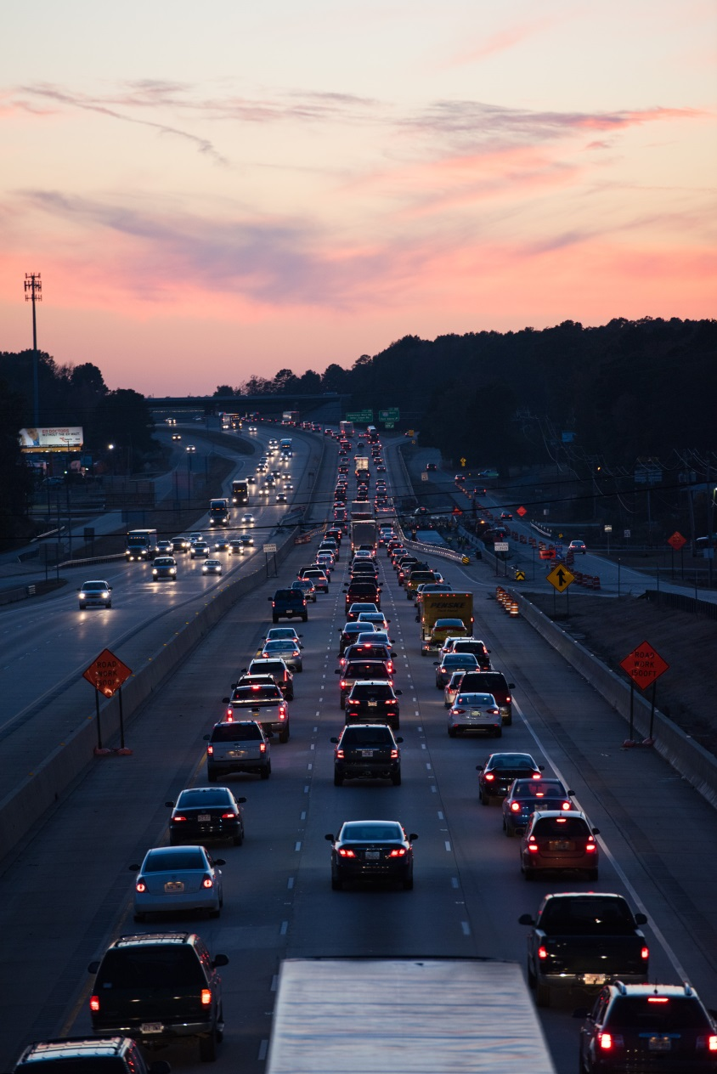
Economic Impact of Infrastructure Investment
Increased Property Values
Attraction to Businesses
  Higher Wages
  More Job Opportunities
Less Expense on Vehicle Wear and Tear = Greater Expendable Income
Safety Benefits
  Reduced Fatalities
  Reduced Property Damage
Notes:
Economic Impact of Infrastructure Investment
Value capture of the economic benefit of adequate infrastructure include increases in property values, desirable locations for businesses resulting in better job opportunities, less wear and tear on vehicles, greater safety, etc.
Infrastructure is a Critical Factor in the State’s Wealth
Infrastructure is a Critical Ingredient in Economic Development at all Levels of Income.
It supports and creates Economic Growth
Enables Private Businesses and Individuals to Produce Goods and Services More Efficiently.
This includes the Trucking Industry. Better roads equates to better fuel efficiency – a savings that can be passed on to the consumer.
Increased Infrastructure Spending by the Government Results in Higher Economic Output
Consider 3rd World Countries – No investment in infrastructure results in no generation of wealth and extreme poverty of its citizens.

Slide 29
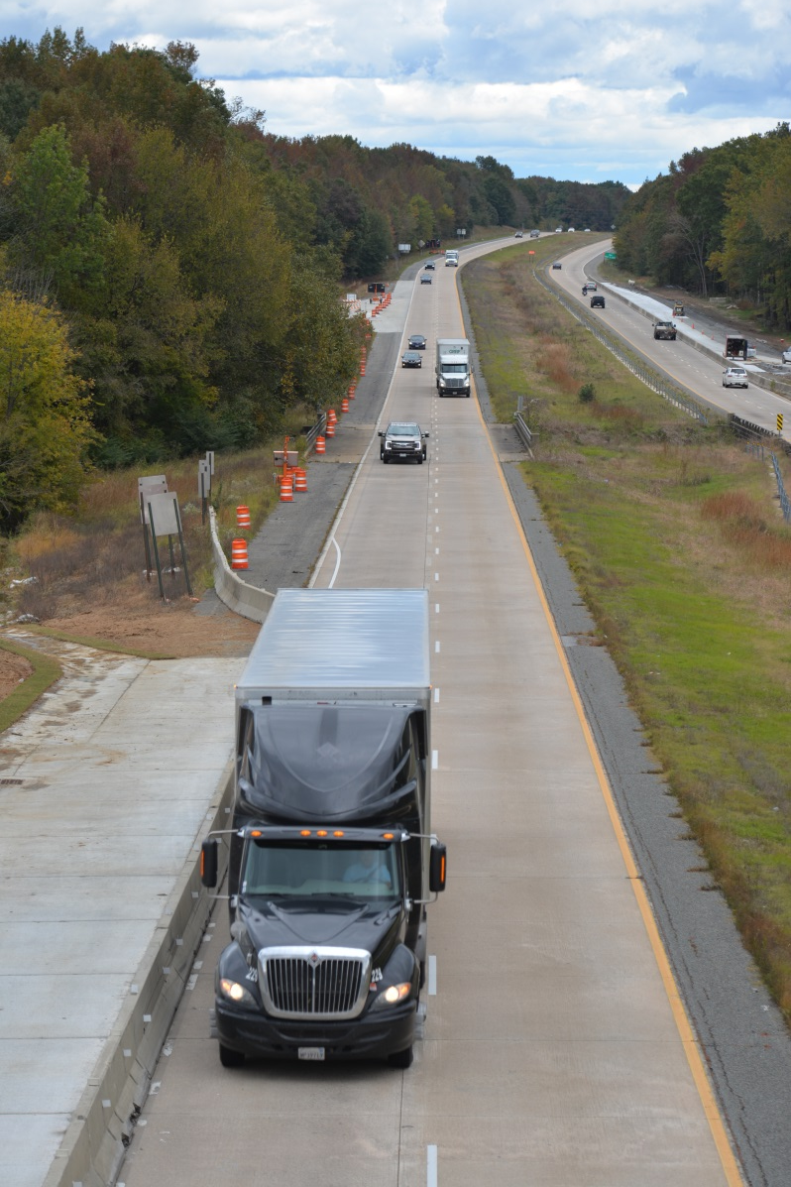
Infrastructure Investment and Quality of Life
Quality of Life is Directly Linked to:
Reliable Access to:
  Housing
  Family, Friends, Spirituality
  Employment
  School
  Health Care
  Recreation/Entertainment
  Consumer Goods
  Consumer Services
Notes:
Quality of Life is also linked closely with the Transportation System Investment, although it is oftentimes taken for granted, more so than electricity, water, sewer, internet, etc.
Quality of life is about well being, security, competence, optimism, freedom in the absence of stress, fear and restrictions.
Value capture of improved quality of life associated with adequate infrastructure includes reliable access to housing, family, friends, jobs, school, health care, recreation, entertainment, shopping, services, etc. We also need to consider the ability for businesses to deliver goods and services to retail outlets or to the consumer.
Infrastructure is a Critical Factor in the State’s Health and Personal Well-being

Slide 30

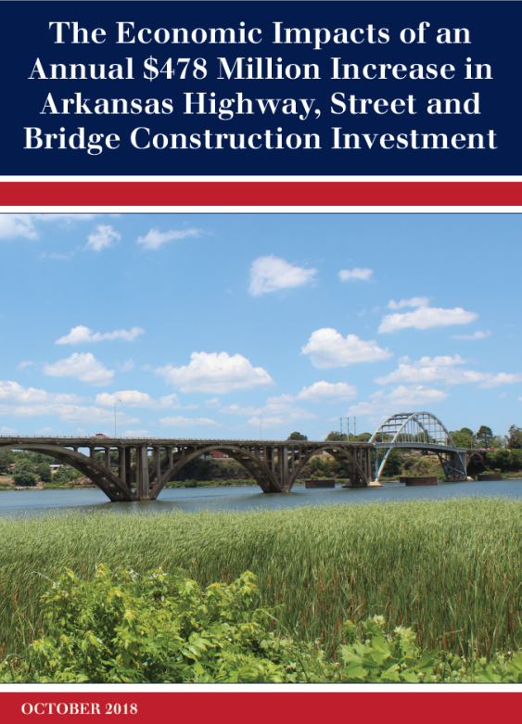
American Road & Transportation Builders Association
$478 Annual Investment Results
Immediate Economic Benefits of Increasing Investment
  Supports $1.3 Billion in Economic Activity
  Supports 5,729 Jobs
Neighbors Are Not Waiting
  Seven Have Raised State Gas Tax
  Six Have Variable Gas Tax
  Eight Have Electric Vehicle Registration Fees
Significant Transportation Challenges
  Safety Needs
  Increasing Freight Demands
  Impacts From Congestion
Notes:
I would like to share with you some research regarding an annual investment of $478 Million that was conducted for the Associated General Contractors of Arkansas (AGC Arkansas) by the economics & research team at the Washington, D.C.-based American Road & Transportation Builders Association (ARTBA).
This investment would not only bring the system up to a state of good repair, but it would also support at least $1.3 billion in annual economic activity across the state (Note: Includes Direct and Indirect Impacts).
It would also support 5,729 jobs throughout all sectors of the economy.
Immediate Economic Benefits of Increasing Investment
Sales and output by businesses will increase by $941.6 million each year.
These investments will contribute $482.1 million to the state gross domestic product.
State and local tax revenues will grow by $56.7 million.
51% of the 5,729 jobs supported or created would be outside of the construction industry.
Those workers will earn an average of $253.0 million per year.

Slide 31

2023 vs. 2024 if ½ Cent Sales Tax Fails
Turnback to Cities
  2023 - $156 million
  2024 - $113 million
  Nearly a 30% Reduction
Turnback to Counties
  2023 - $156 million
  2024 - $113 million
  Nearly a 30% Reduction
Notes:
There’s no question that the revenue is desperately needed to take care of our existing highway system.
We need a long-term, sustainable revenue source to take care of and upgrade what we already have, and making this tax permanent would be a perfect fit.
I’m going to predict that mayors and county judges will be very vocal as the vote for the Constitutional Amendment approaches.
I mentioned earlier that if the proposed Constitutional Amendment passes, it would continue to send about $86 million annually to the cities and counties.
But if the proposed Constitutional Amendment fails at the polls, every city and county in the state will lose that revenue for their road departments for county roads and city streets.
As you can see on the screen, cities and counties combined will lose about $866 million if the constitutional amendment fails. That’s almost a 30% decrease in their annual road and street budgets.
That would be devastating for them.

Slide 32
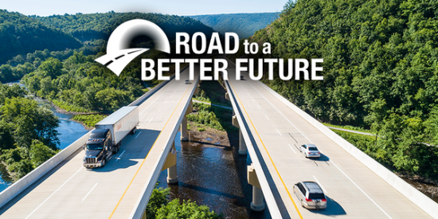
Looking Forward
ARDOT / Cities / Counties
Educate Public
Stakeholders
Educate Public
Campaign
Notes:
So, there is a lot at stake for the future of not only our roads but our quality of life.
The final 2/3rds of the Governor’s Highway Package will be funded by the extension of the tax.
It is imperative that all of us do everything we can to educate voters on the benefits of extending the ½ cent sales tax.

Slide 33
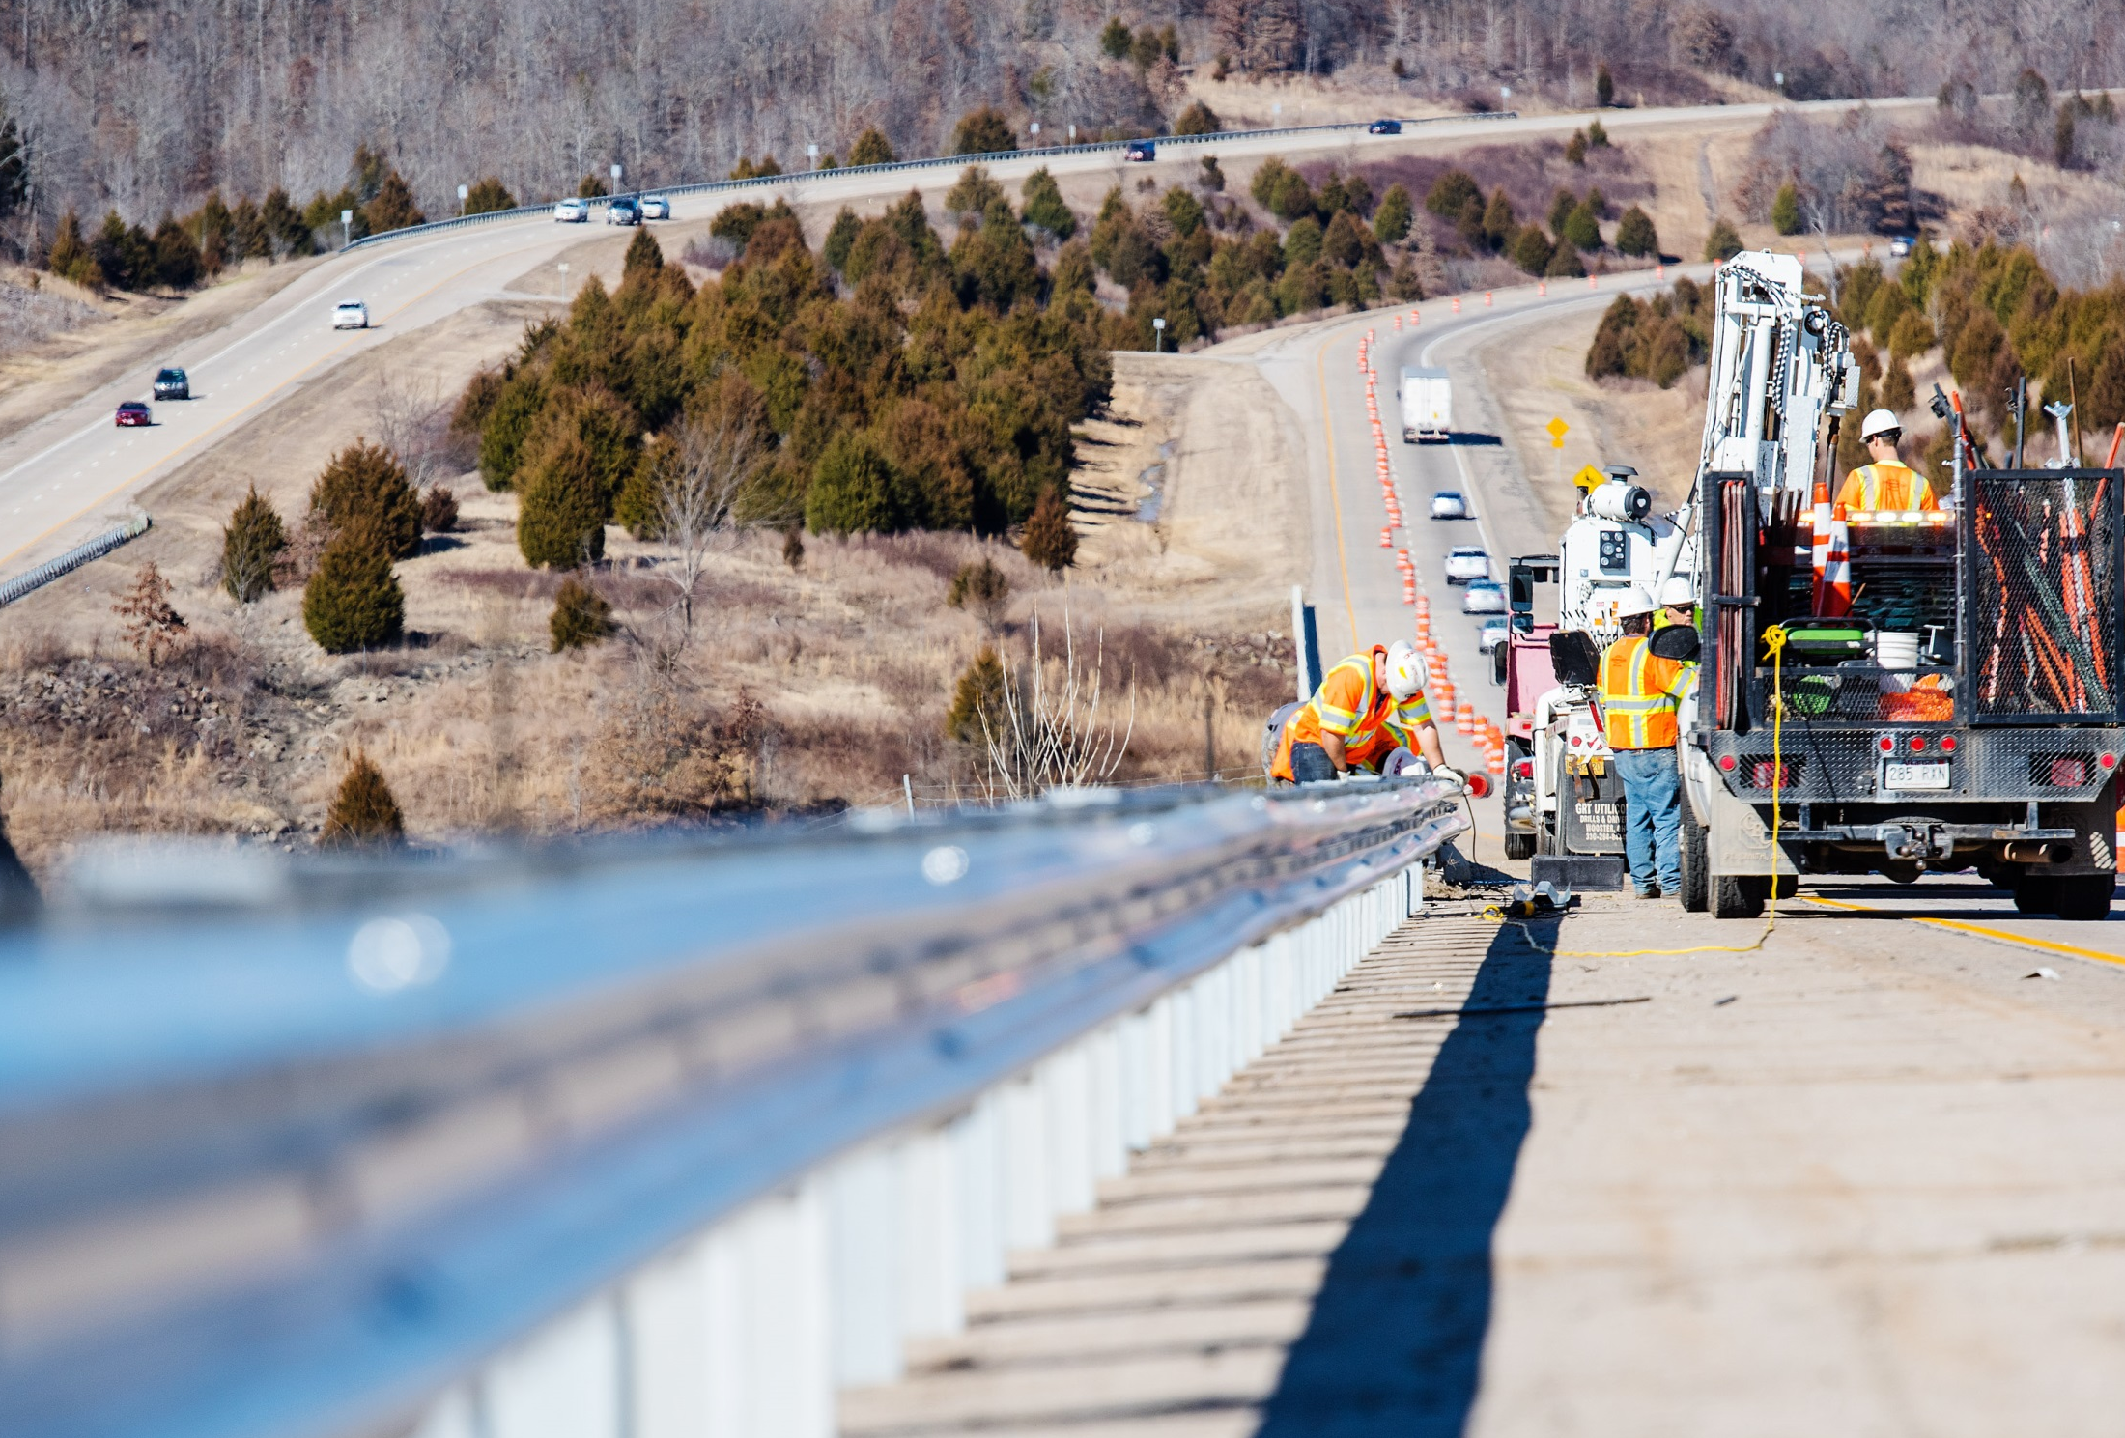
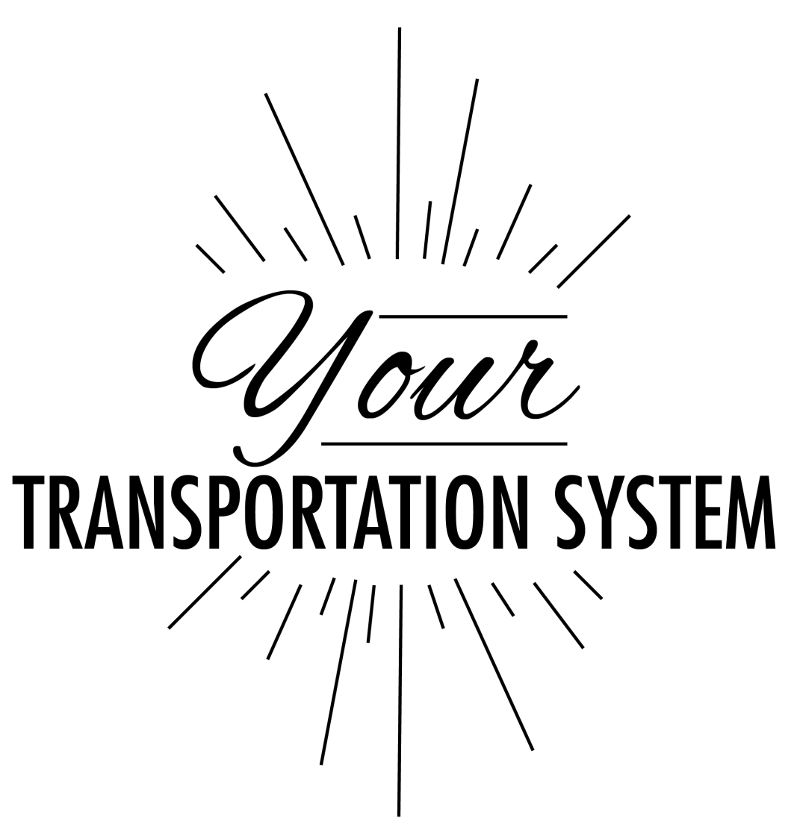
Arkansans Need to Decide How to Fund
Notes:
So the legislature has done their part this time, and the people will have the final say in November 2020. It’s up to the citizens to decide if they want to invest more to take care of our existing highway system – to resurface roads, improve the ride quality, widen or add shoulders, and replace bridges.
I’ll be happy to take any questions you might have.

Slide 34
Questions?

